Slide 1

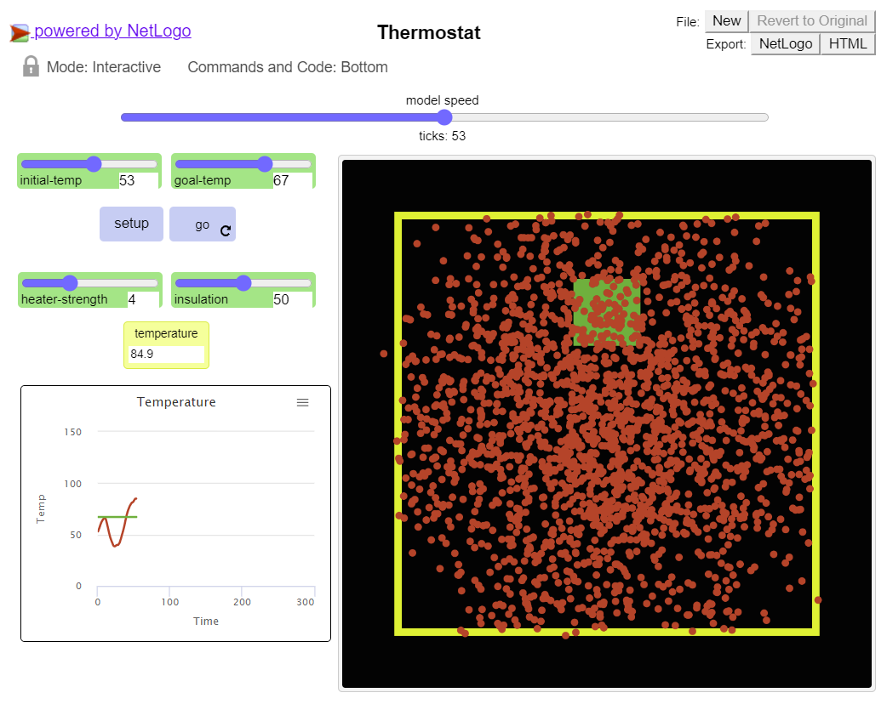
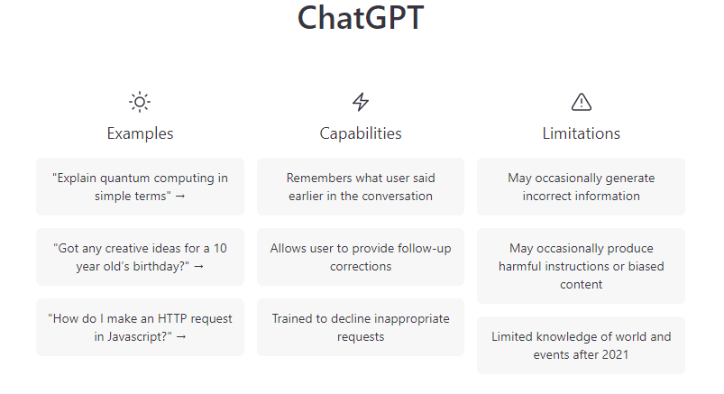

CSC485B Machine Learning for Robotics
SUNY Plattsburgh
Dr. Ned Lecky
Class 18: Agent Based Modeling and ChatGPT

Slide 2

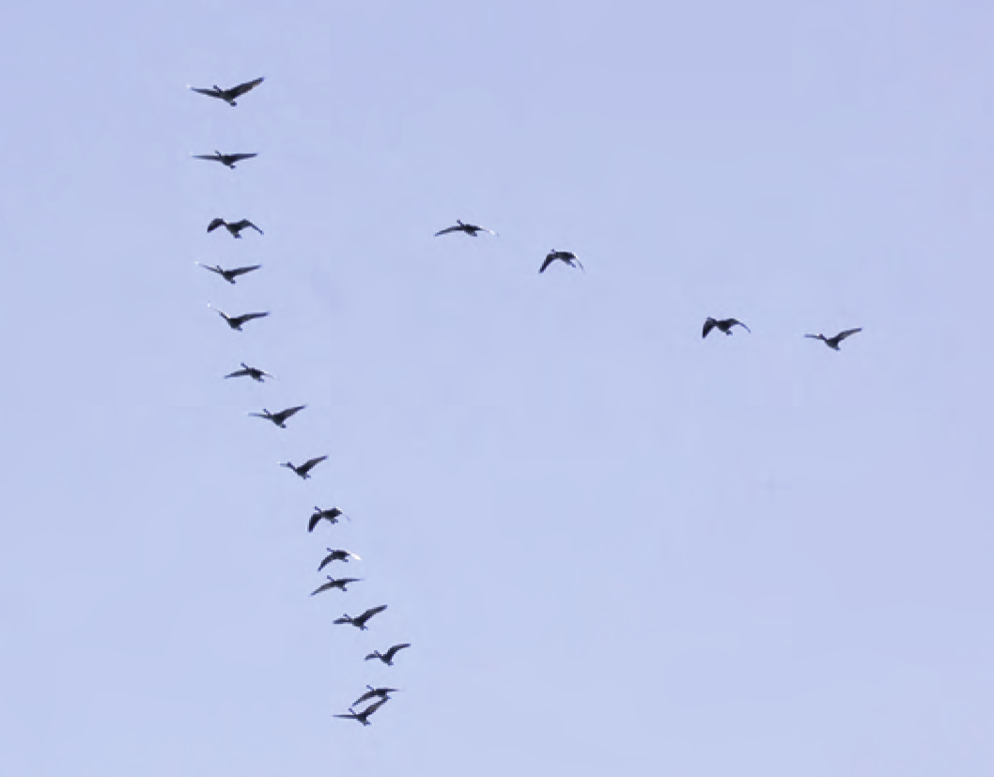
Agent Based Modeling
Anthology of Articles, Websites, Software
https://www.publichealth.columbia.edu/research/population-health-methods/agent-based-modeling
A cool and very simple implementation: NetLogo

Slide 3
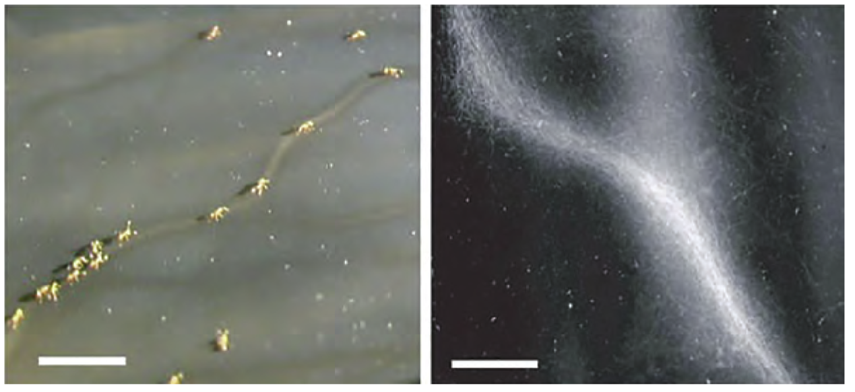
Agent Based Modeling with NetLogo
Some demonstrations:
Random Bouncing Balls- 40 lines of code!
http://www.netlogoweb.org/launch#http://www.netlogoweb.org/assets/modelslib/Sample%20Models/Chemistry%20&%20Physics/Mechanics/Random%20Balls.nlogo
Traffic- 120 lines of code
http://www.netlogoweb.org/launch#http://www.netlogoweb.org/assets/modelslib/IABM%20Textbook/chapter%205/Traffic%20Basic%20Adaptive%20Individuals.nlogo
Ant Simulation with Pheromone signaling- 140 lines of code
http://www.netlogoweb.org/launch#http://www.netlogoweb.org/assets/modelslib/Sample%20Models/Biology/Ants.nlogo

Slide 4
Examples specific to our use case
Maze Generation- 100 lines of code
http://www.netlogoweb.org/launch#http://ccl.northwestern.edu/netlogo/community/BAM%20Maze%20Generator2.nlogo
Chaos in a Box- 300 lines
http://www.netlogoweb.org/launch#http://www.netlogoweb.org/assets/modelslib/Sample%20Models/Chemistry%20&%20Physics/Chaos%20in%20a%20Box.nlogo
Setup various obstacles: drag and resize
Run one or two turtles and they bounce off things
Could be used to generate a dataset and then create driving rules?

Slide 5
NetLogo: More Information
The Website
http://ccl.northwestern.edu/netlogo/
The Tutorial
http://ccl.northwestern.edu/netlogo/bind/
The Textbook
Available FREE online through Feinberg
https://ebookcentral.proquest.com/lib/plattsburgh-ebooks/reader.action?docID=3339969
This could be an “easy” way to generate training data similar to last week in the Intel course
But we’d need File Output… ☺
http://ccl.northwestern.edu/netlogo/docs/programming.html#output

Slide 6
What Can We Do With…
ChatGPT
I don’t know if it will “win” or get “suppressed” or “commercialized”
But something like it, and better, will exist for as long as we have the ability to run the Internet

Slide 7
ChatGPT as a Tool
This WILL BE part of software development workflow for as long as the Internet exists
So, we might as well get adept at using it
I put several trial runs on the GitHub, but I’m more interested in trying from scratch!
Queries I have tried
Show me how to use a neural network to convert from Celsius to Fahrenheit
Can you do it in scikit-learn?
Can you do it in PyTorch?
Write me a python program to compute the Pythagorean theorem using a neural network in PyTorch
solve the iris database clustering problem using pytorch
This one is fascinating!

Slide 8
Assignment
If you can’t beat ‘em, join ‘em!
Solve a regression, classification, and clustering problem
Use ChatGPT to get you started (or finished)
Evaluate the results
Evaluate the code quality

